Slide 1
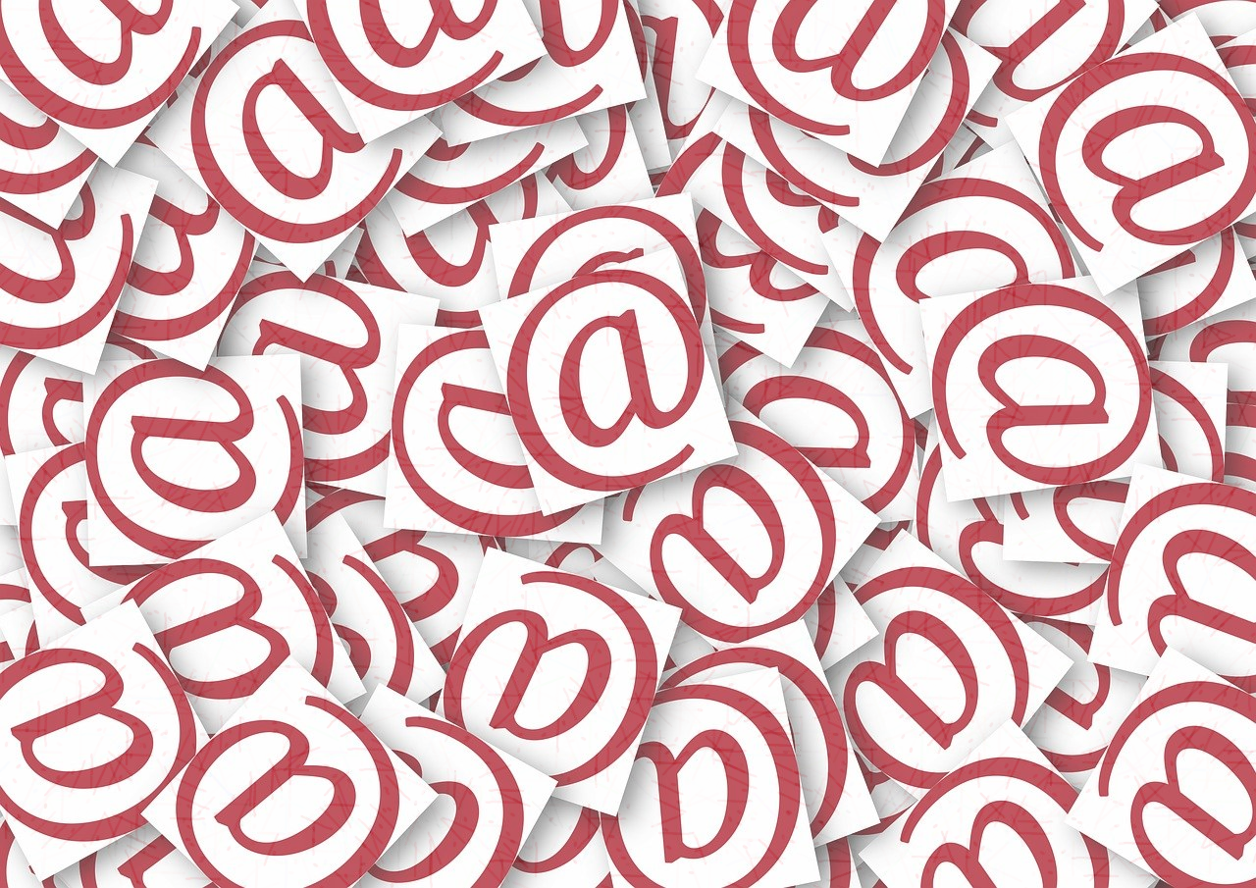
Writing em@ils
in English

Slide 2
Konkurs polega na wybraniu jednej prawidłowej odpowiedzi w każdym pytaniu.
Wypełnione karty odpowiedzi prosimy wysyłać na adres:
karolina.kaluzna@put.poznan.pl
Data zakończenia konkursu: 29.05.2024r.
Wśród autorów poprawnych odpowiedzi zostaną rozlosowane atrakcyjne nagrody.
KONKURS PRZEZNACZONY JEST DLA STUDENTÓW PP
ŻYCZYMY POWODZENIA !

Slide 3
Choose the correct answer.
Send the answer sheet to: karolina.kaluzna@put.poznan.pl
The deadline is: May 29, 2024
The contest winner will receive an attractive prize.
THE QUIZ IS AIMED AT PUT STUDENTS
GOOD LUCK!

Slide 4
11.
In an email address, what is the ’@’ sign called?
monkey
sent
at
2.
When submitting a job application
via email, how would you start
if you didn’t know who the recipient is?
Dear Sir
To whom it may concern
Dear John or Jane

Slide 5
3.
Which formal email topic introduction is grammatically correct?
I’m writing regarding to our contract renewal.
I’m writing with regard to our contract renewal.
c) I’m writing concerned our contract renewal.
4.
Which request is grammatically correct?
Would you mind to extend the deadline?
I would appreciate it you extended the deadline.
Would it be possible to extend the deadline?

Slide 6
5.
Which sentence informing about an attached document is NOT correct?
a) Please find attached my assignment.
b) In the attached, you’ll find my assignment.
c) I’ve attached my assignment.
6.
Complete the sentence:
I’m … you in on any correspondence regarding the matter.
forwarding
copying
passing

Slide 7
7.
Which sentence does NOT mean
Please keep me updated?
Please keep me in the loop.
I’d appreciate regular updates on this matter.
Please keep my post.
8.
Which pair of email acronyms BOTH refer to time?
ASAP/ FAO
EOD/ EOW
BCC/ IAM

Slide 8
19.
Which sentence is NOT an email closing line?
I look forward to hearing from you.
I hope this email finds you well.
If you require any further information,
please do not hesitate to contact me.
10.
How do you sign off an email if you want to be respectful, but not too personal or too formal?
Take care
Regards
Sincerely

