Slide 1
FESTIVE APRIL

Slide 2
Konkurs polega na wybraniu poprawnej odpowiedzi.
Wypełnione karty odpowiedzi prosimy wysyłać na adres:
aneta.antokolska@put.poznan.pl
Data zakończenia konkursu: 23.04.2024r.
Wśród autorów poprawnych odpowiedzi zostaną rozlosowane atrakcyjne nagrody.
KONKURS PRZEZNACZONY JEST DLA STUDENTÓW PP
ŻYCZYMY POWODZENIA !

Slide 3
Choose the correct answer.
Send the answer sheet to: aneta.antokolska@put.poznan.pl
The deadline is: April 23, 2024.
The contest winner will receive an attractive prize.
THE QUIZ IS AIMED AT PUT STUDENTS
GOOD LUCK!

Slide 4
1
If you’re looking for an excuse to pull a harmless prank on your friends and family - …………. is here. The day is widely celebrated and enjoyed as an opportunity to be silly.
a) April Prank Day
b) Hide-and-Seek Day
c) April Fools’ Day

Slide 5
2
An ………………….is a popular activity often associated with Easter celebrations in many English-speaking countries. During an event, children, and sometimes adults too, search for hidden eggs, typically decorated or filled with candies or small toys.
egg race
egg dance
egg hunt

Slide 6
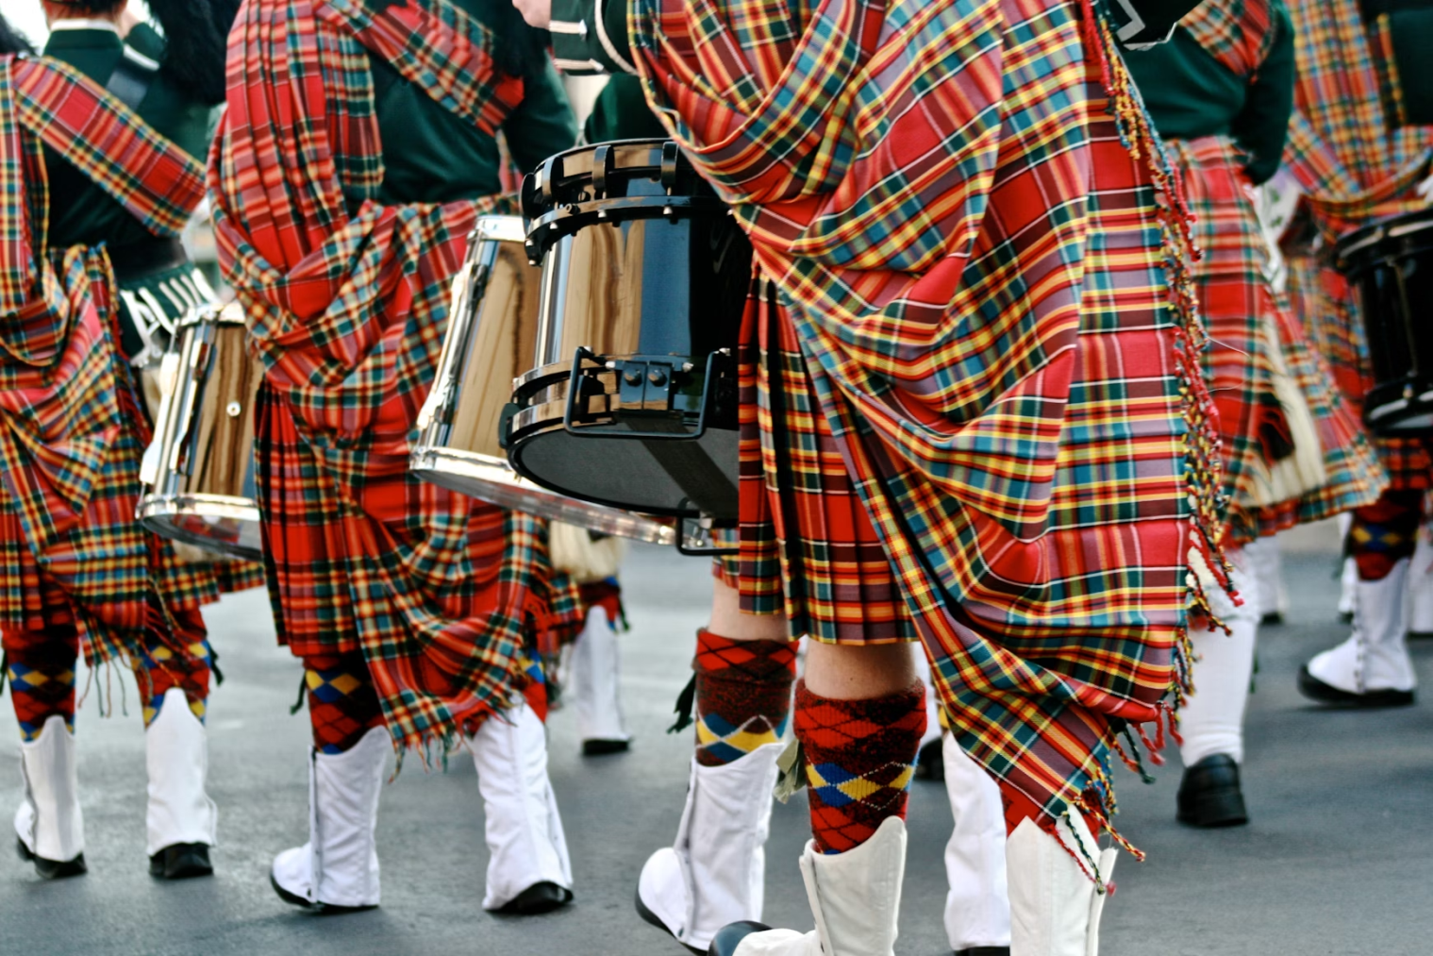
3
……………is celebrated on April 6th each year in Scotland and by people of Scottish descent around the world to celebrate Scottish culture, heritage, and identity. Some cities and towns in Scotland organize parades, where participants dress in traditional Scottish clothing.
Tartan Day
Bagpipe Day
Highland Day

Slide 7
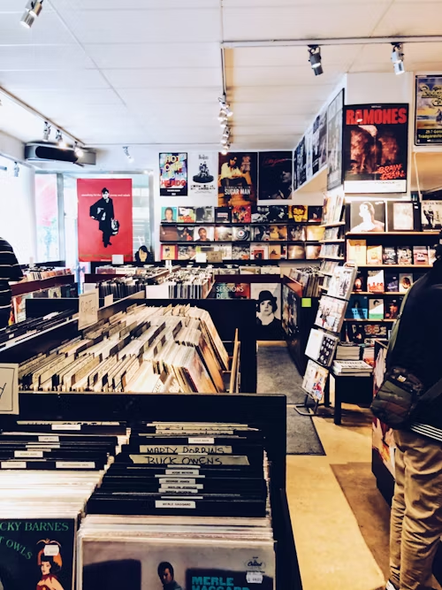
4
………………………typically takes place on the third Saturday of April each year. During that day, music stores worldwide offer exclusive vinyl releases, special editions, reissues, and other limited-edition music releases that are available only on that day.
a) Record Store Day
b) Vinyl Festival
c) Spotify Day

Slide 8
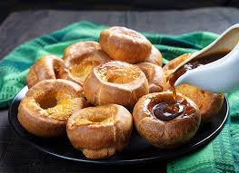
5
What is a traditional dish eaten on St. George's Day, the patron saint of England, celebrated on April 23rd?
a) pumpkin
b) roast beef and Yorkshire pudding c) roast turkey

Slide 9
6
What is the primary focus of Earth Day on April 22nd?
a) celebrating space exploration b) raising awareness about environmental issues c) promoting digital literacy

Slide 10
7
How do Australians and New Zealanders traditionally celebrate ANZAC Day (Australian and New Zealand Army Corps that served in conflicts and wars, particularly during World War I), observed annually on April 25th?
by dressing up as soldiers and marching in the streets
by baking ANZAC biscuits and attending dawn services
by hosting a BBQ party at the beach

Slide 11
8
What is a common activity during Earth Day celebrations?
a) planting trees while wearing superhero costumes
b) organizing "Trashy Fashion Shows" featuring outfits made from recycled materials
c) singing serenades to houseplants to encourage growth

Slide 12
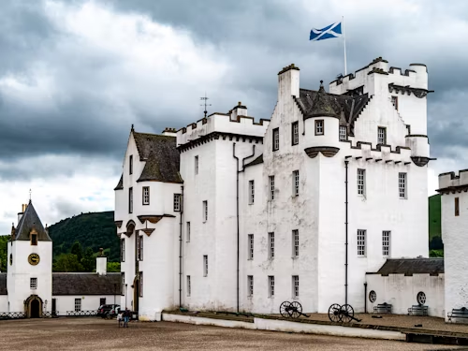
9
What is a traditional Scottish garment worn on April 6th to celebrate Scottish culture?
a) kilt
b) tuxedo
c) kimono

Slide 13
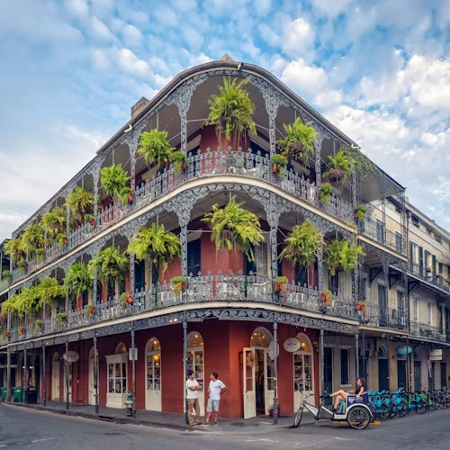
10
What is the name of the iconic music festival celebrated in New Orleans, Louisiana, typically held in April and May?
Coachella Valley Music and Arts Festival
Jazz & Heritage Festival (Jazz Fest)
Burning Man Festival

